Slide 1
PHONEPE PULSE INSIGHTS
Indhumathy Thangavelu
Mail:indhumathy1206@gmail.Com

Slide 2
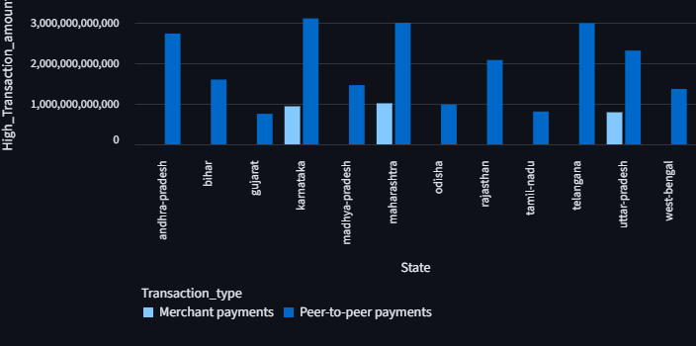
SCENARIO 1 DECIPHERING THE TRANSACTION PROCESS: NAVIGATING PHONEPE SCENARIO 1 DECIPHERING THE TRANSACTION PROCESS: NAVIGATING PHONEPE
Maharashtra -leader in value in overall years.
Karnataka and Uttar Pradesh - significant growth potential in recent years.
Merchant payments account for only a quarter of the volume seen in peer-to-peer payment transactions.
Northeastern Indian states are currently falling behind in transaction activity.

Slide 3
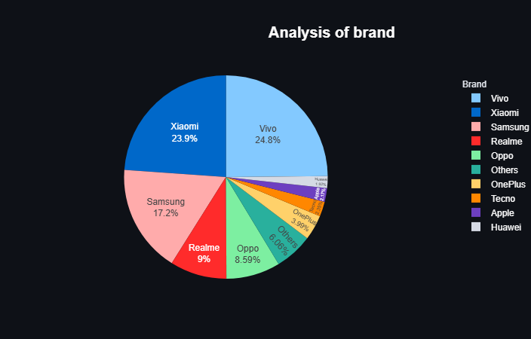
SCENARIO 2
DEVICE DOMINANCE AND USER ENGAGEMENT ASSESSMENT
Highest number of registered users:-
Maharashtra, Uttar Pradesh, and Karnataka
Leading Brands: Xiaomi, Vivo, and Samsung.
Frequent Users: Karnataka
Noteworthy Observation: Despite having the highest number of registered users, Maharashtra does not rank among the most frequent users of the application.

Slide 4
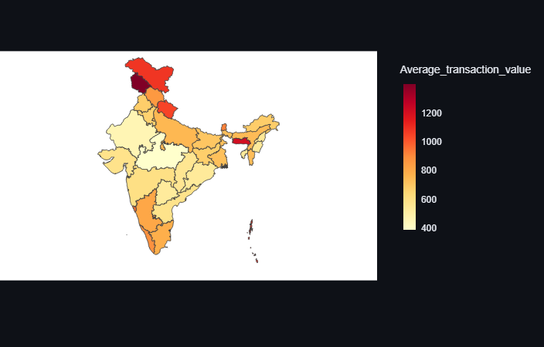
SCENARIO 3
INSURANCE PENETRATION AND GROWTH POTENTIAL ANALYSIS
Maharashtra, Andhra Pradesh, and Karnataka: Higher total insurance amount.
Lower average ticket size, indicating that the average transaction value is less.
Jammu & Kashmir, Ladakh, and Uttarakhand: These regions are considered "Premium States."

Slide 5
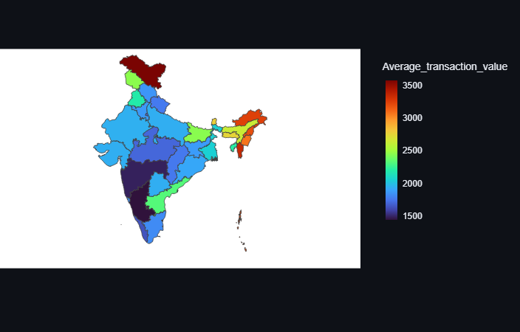
SCENARIO 4
TRANSACTION ANALYSIS FOR MARKET EXPANSION
• Volume Leaders:
Karnataka, Telangana, and Maharashtra.
• Value Leaders:
Manipur, Mizoram, Nagaland, and Ladakh.
• Northern & Eastern states may show growing
adoption but smaller ticket sizes
→ future growth markets.
On a year-over-year basis, the average transaction value has declined, indicating that customers are making smaller-value transactions compared to the previous year.
Western India (Maharashtra, Gujarat) often shows higher transaction value due to urban wealth concentration.

Slide 6
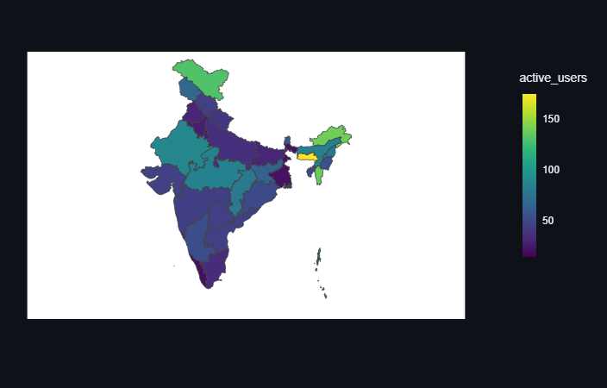
SCENARIO 5
USER ENGAGEMENT AND GROWTH STRATEGY
The leading users of the application, both in terms of registration and frequency of use.
Maharashtra and Karnataka.
Although Uttar Pradesh, Rajasthan, Telangana, and Tamil Nadu have a higher number of registered users, where market reached saturation level there is significant potential for increasing user engagement in these states.
Meghalaya, Arunachal Pradesh, Mizoram and Ladakh are high loyal user states where phonepe has to focus on user acquisition.

Slide 7
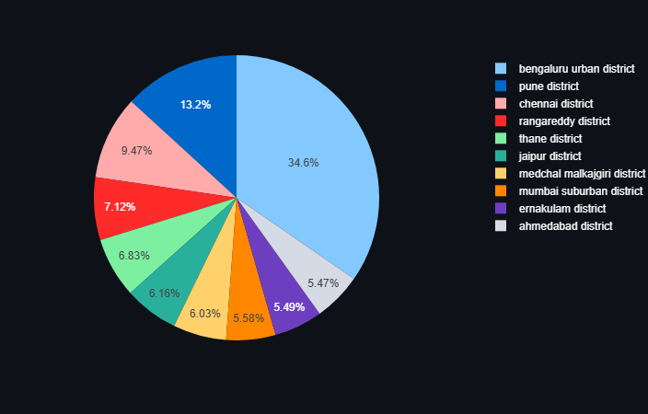
SCENARIO 6
INSURANCE ENGAGEMENT ANALYSIS
Micro-market insurance insights.
Districts with Dominant Value Leaders:
Bengaluru Urban, Pune, Rangareddy and Thane.
This indicates that Karnataka and Maharashtra play a significant role in this context.
Small ticket policies must be engaged to make mass adoption.

Slide 8
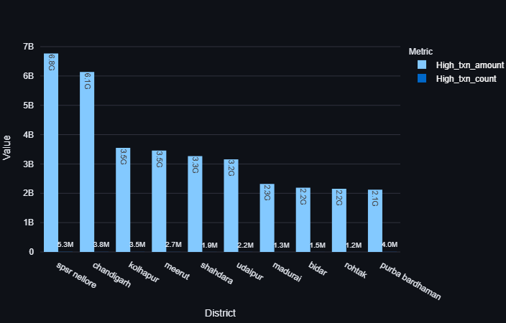
SCENARIO 7
TRANSACTION ANALYSIS ACROSS STATES AND DISTRICTS
• Andhra Pradesh - volume leader to date.
• The district champions for maximum transaction amounts:Prakasam, YSR, and Eluru.
Looking ahead, Raigad and Mumbai districts in Maharashtra, along with Siddipet in Telangana,
are poised to become potential volume leaders.
While the transaction count of the above districts has been steadily increasing over the years, it has yet to achieve the status of value leader.

Slide 9
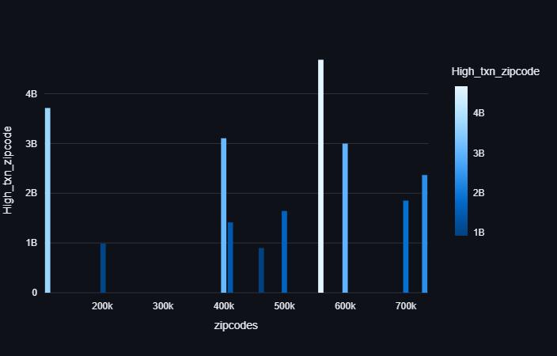
Telangana: A Hub of Micro-Level Champions
The districts of Siddipet and Bhadradri Kothagudem have each produced a single city that has attained the volume leader status, highlighting their potential.
Following closely is Ballari district in Karnataka, where a single city is emerging as the next potential volume leader.

Slide 10
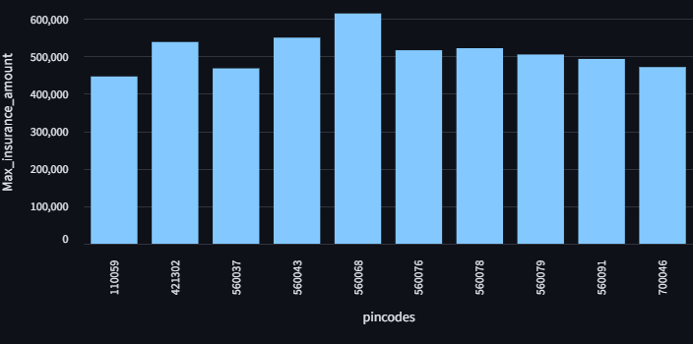
SCENARIO 9
INSURANCE TRANSACTIONS ANALYSIS
Karnataka and Maharashtra accounted for more than 40% of the overall insurance value, despite having a low transaction volume, largely influenced by urban areas like Mumbai and Bengaluru.
The urban centers of Karnataka and Maharashtra serve as the key players at the micro level.

Slide 11
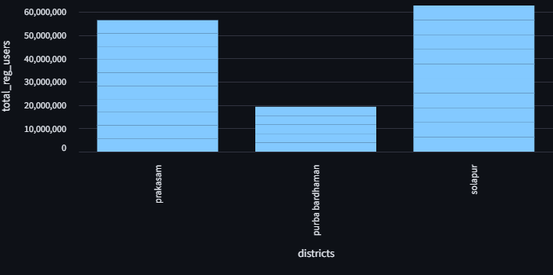
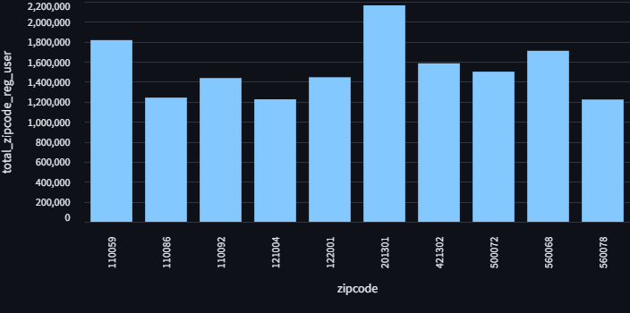
SCENARIO 8
USER REGISTRATION ANALYSIS
The districts boasting the most registered users are Solapur (Maharashtra), Prakasam (Andhra Pradesh), Purba Bardhaman, and Paschim Bardhaman (West Bengal), along with Bareilly (Uttar Pradesh).
On a more granular level, the cities making a significant impact are Bareilly (Uttar Pradesh), Shadhara (Delhi), and Vijayapura (Andhra Pradesh).

Slide 12
Technologies Utilized:-
Programming Language: Python 3
RDBMS: MySQL Server
Application Framework: Streamlit
External Resources: Google, GitHub
THANK YOU

